Slide 1

Major Losses Reserving
Duc Hien Vu
November / Paris
Notes:
To change the logo in the footer, go to the VIEW menu > Master > Slide Master, and replace the existing logo by your entity's logo.
To edit the confidentiality level, go to the INSERT menu > Header and footer, and fill in the desired level.

Slide 2
CONTENTS
ML Reserving Framework P.3
Research approaches P.6
IBNeR Projection P.12
IBNyR Projection P.21
Economic Allocation P.29
Notes:
Page numbers are flushed right using the tab function ("->” key or "TAB" key), and are formatted manually (Century 12 pt., dark blue).
Chapters are numbered automatically.
To edit the footer for the entire document, go to INSERT > Header and footer, and fill in the desired titles and dates.
The vertical line should be adjusted manually.

Slide 3
1
ML Reserving Framework
ML threshold, ML vision, ML reserving process
Notes:
The background color can be changed using the slide’s background color commands (preferably using the color palette). Note that we recommend using either this color or that of the following slide (10th color of the predefined palette).
(right click on the slide + “Format background”). Here, the 4th color of the predefined palette was chosen.

Slide 4
ML Reserving Framework
ML threshold – ML vision
ML thresholds retained by AXA CS:
France, Germany, Spain, Italy, Austria: 3M EUR
Unied Kingdom: 2M GBP
Switzerland: 4M CHF
Hong Kong, Singapour, Australia: 5M USD
« Once atypical, forever atypical »:
a claim is considered as Major Loss (ML) as soon as its Incurred is above the ML threshold, regardless of its ultimate position.
Reason: to ensure the stability of the attritionnal claims reserving process.
Challenge: In ML Reserving, a claim can settle above or below the ML threshold. For the IBNyR projection, we need to separate 2 cases of Ultimate and estimate severity in each case.

Slide 5
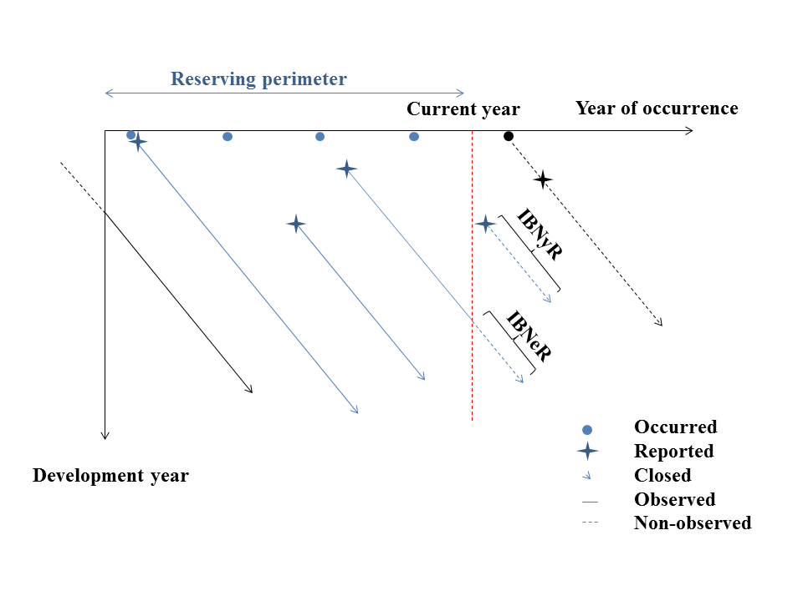
ML Reserving Framework
IBNR = IBNeR + IBNyR

Slide 6
2
Research approaches
Litterature review, Reference Models
Notes:
The background color can be changed using the slide’s background color commands (preferably using the color palette). Note that we recommend using either this color or that of the following slide (10th color of the predefined palette).
(right click on the slide + “Format background”). Here, the 4th color of the predefined palette was chosen.

Slide 7
Research approaches
Litterature Review
Aggregated methods (run-off triangle + Exposure)
Chain-ladder vision
A priori vision
Other methods that give credibility to the 2 extreme visions
Individual methods
Great reflexion basis
Not directly adapted to the context of AXA CS

Slide 8
Research approaches
Referential models
Model 2 adjusted: adapted version of Model 2 to AXA CS vision
Both model 1 and Model 2 adjusted present shortcomings.
 | Model 1 | Model 2
IBNeR | Individual methods
 | Ultimate factor estimated by P/I ratio | Individual Chain-ladder
IBNyR | Aggregated method
 | ALR | Schnieper

Slide 9
Research approaches
Ideas for improvements
IBNeR Projection
New Individual Chain-ladder: impact of claims proximity (Individual Chain-ladder of Model 2 + ICD + kNN): retained
Individual Munich Chain-ladder (Individual Chain-ladder + Munich Chain-ladder): rejected
IBNyR Projection
Schnieper: rejected
2 extreme visions (Chain-ladder, a priori): rejected
Benktander-Hovinen, ALR, Cape-Cod, Bornhuetter-Ferguson
Retained method: Mixed Bornhuetter-Ferguson

Slide 10
Individual Chain-ladder for IBNeR projection & Mixed Bornhuetter-Ferguson for IBNyR projection
Retained Model
Notes:
The background color can be changed using the color commands of the slide background (preferably selecting from among the colors of the predefined palette).
(right click on the slide’s background + “Format background”).

Slide 11
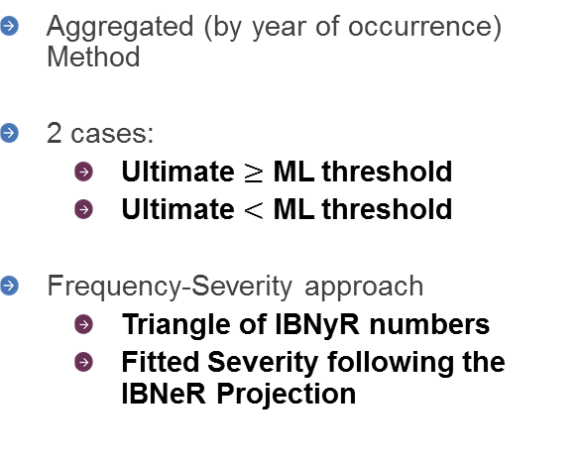
ML Reserving Framework
ML Reserving Process
IBNeR projection
Ibnyr projection
Individual Chain-ladder
To be developed: active claims that have reached the ML threshold
link-ratio: weighted mean of individual development factors. The weight is based on proximity between claim to be developed and referential claims.
Aggregated (by year of occurrence) Method
2 cases:
Ultimate $≥$ ML threshold
Ultimate $<$ ML threshold
Frequency-Severity approach
Triangle of IBNyR numbers
Fitted Severity following the IBNeR Projection

Slide 12
3
IBNeR Projection
Individual Chain-ladder
Notes:
The background color can be changed using the slide’s background color commands (preferably using the color palette). Note that we recommend using either this color or that of the following slide (10th color of the predefined palette).
(right click on the slide + “Format background”). Here, the 4th color of the predefined palette was chosen.

Slide 13
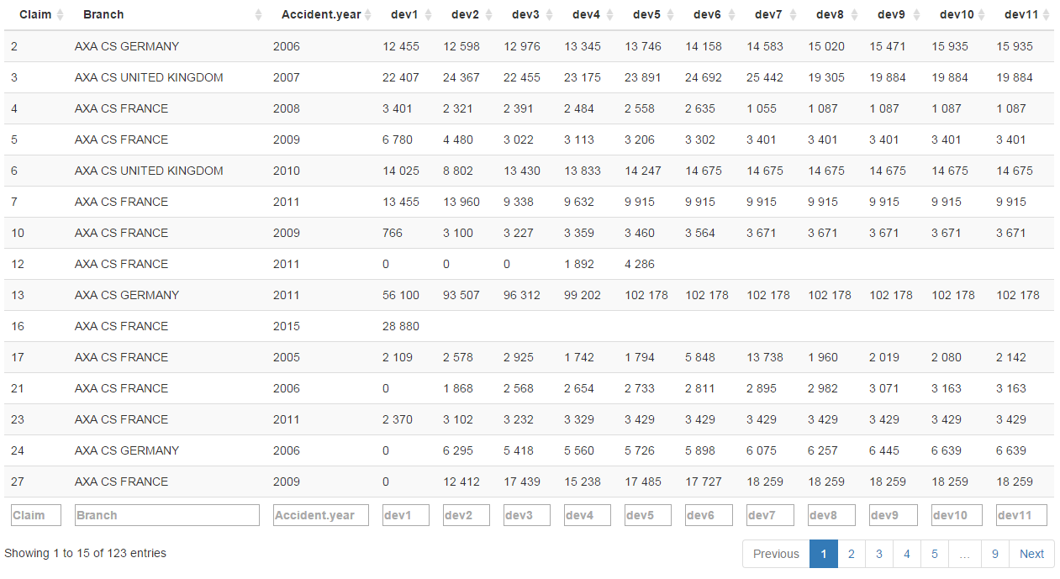
IBNeR projection
Individual approach
To be developed: opened claims that Incurred has reached ML threshold
Closed claims
Active claims
? ? ? ? ? ?
? ? ? ? ? ? ? ? ? ?

Slide 14
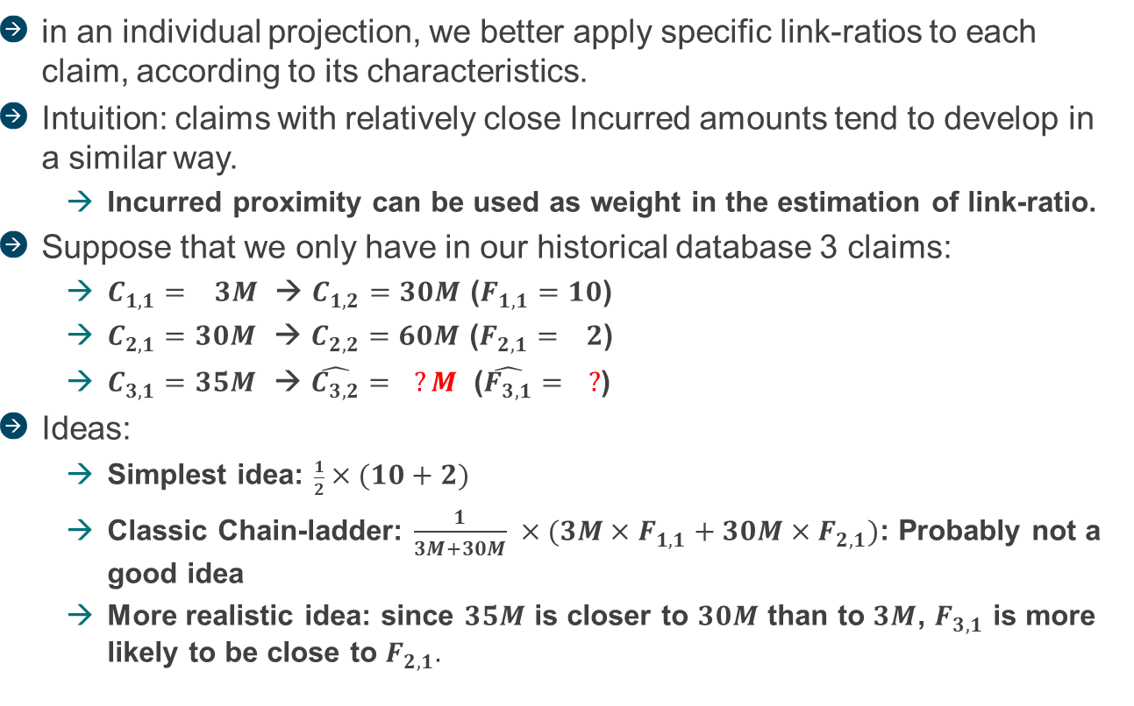
IBNeR projection
Link-ratios
in an individual projection, we better apply specific link-ratios to each claim, according to its characteristics.
Intuition: claims with relatively close Incurred amounts tend to develop in a similar way.
Incurred proximity can be used as weight in the estimation of link-ratio.
Suppose that we only have in our historical database 3 claims:
$C_{1,1}=$ $3M$ → $C_{1,2}=$ $30M$ ($F_{1,1}=$ $10$)
$C_{2,1}=$ $30M$ → $C_{2,2}=$ $60M$ ($F_{2,1}=$ $2$)
$C_{3,1}=$ $35M$ → $\hat{C_{3,2}}=$ $?M$ ($\hat{F_{3,1}}= ?$)
Ideas:
Simplest idea: $\frac{1}{2}×(10+2)$
Classic Chain-ladder: $\frac{1}{3M+30M} ×(3M×F_{1,1}+30M×F_{2,1})$: Probably not a good idea
More realistic idea: since $35M$ is closer to $30M$ than to $3M$, $F_{3,1}$ is more likely to be close to $F_{2,1}.$

Slide 15
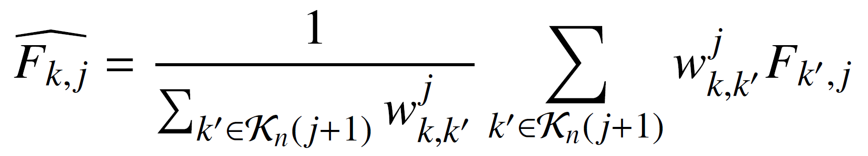

IBNeR projection
Link-ratios
Esimated link-ratio for claim $k$, using reference claims $k^{′}$:
Weight given to reference claim k’, based on Incurred proximity between k and k’
A specific link-ratio for each claim k
(different from classic Chain-ladder)
A weighted mean of reference individual development factors
reference individual development factors
Subset of claims whose Incurred are known in development year j+1

Slide 16
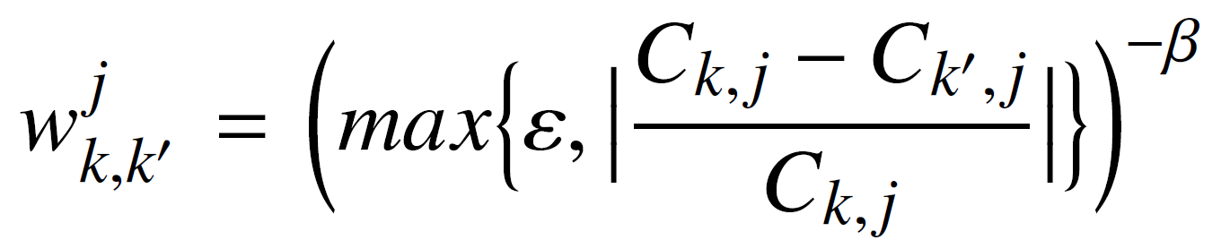
IBNeR projection
Link-ratios
The weight
Tolerance parameter, introduced to not overweight claims that are too close to the claim to be developed
Parameter measuring the impact of claims proximity on their development
Distance (measured in development year j) between 2 claims k and k’

Slide 17
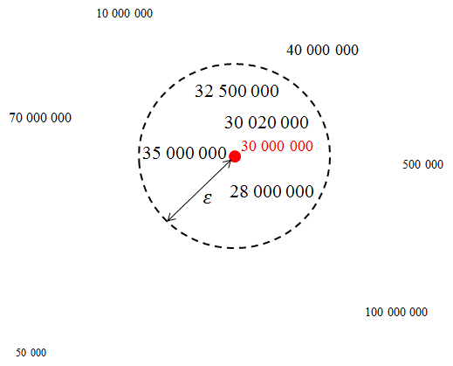
IBNeR projection
Link-ratios
Tolerance parameter
Neighborhood of C_{k,j} = 30 000 000
Inside of this neighborhood, reference claims are equally weighted → a claim with atypical development and Incurred too close to 30 000 000 will not seriously affect our estimation of link-ratio
Outside of this neighborhood, reference claims impact is penalized by their distance to 30 000 000

Slide 18
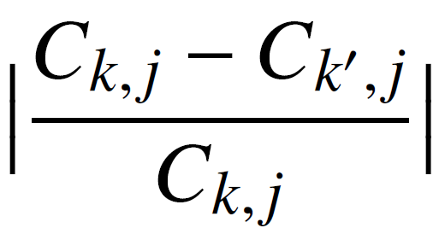
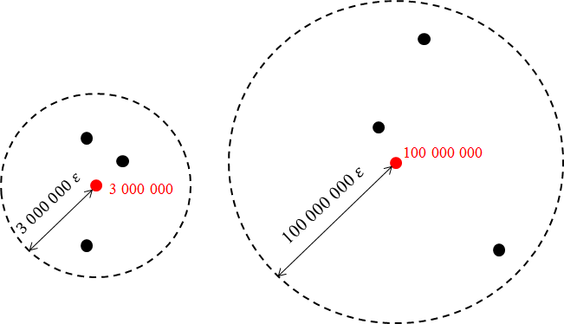

IBNeR projection
Link-ratios
Tolerance parameter
The bigger C_{k,j} is, the wider its neighborhood is
Why normalize claims distance ?
To form this neirghborhood
Very large claims are rare, we want to extend their neighborhood to have enough « neigbour » points

Slide 19
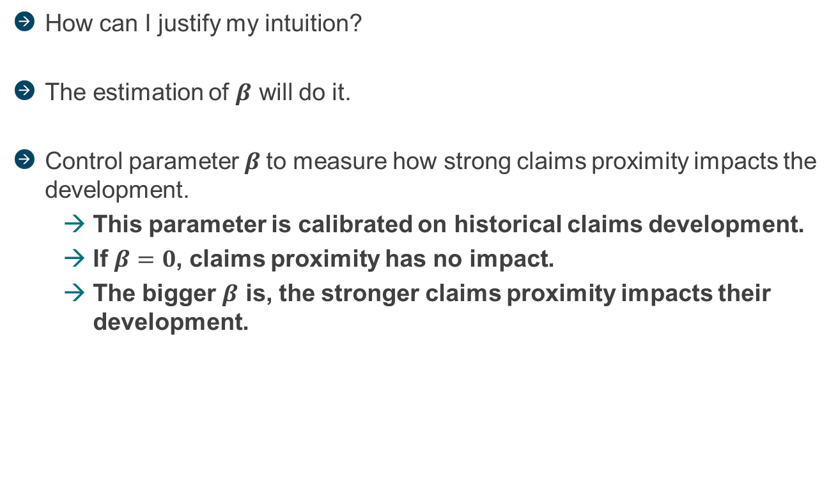
IBNeR projection
Individual Chain-ladder
How can I justify my intuition?
The estimation of $β$ will do it.
Control parameter $β$to measure how strong claims proximity impacts the development.
This parameter is calibrated on historical claims development.
If $β=0$, claims proximity has no impact.
The bigger $β$ is, the stronger claims proximity impacts their development.

Slide 20
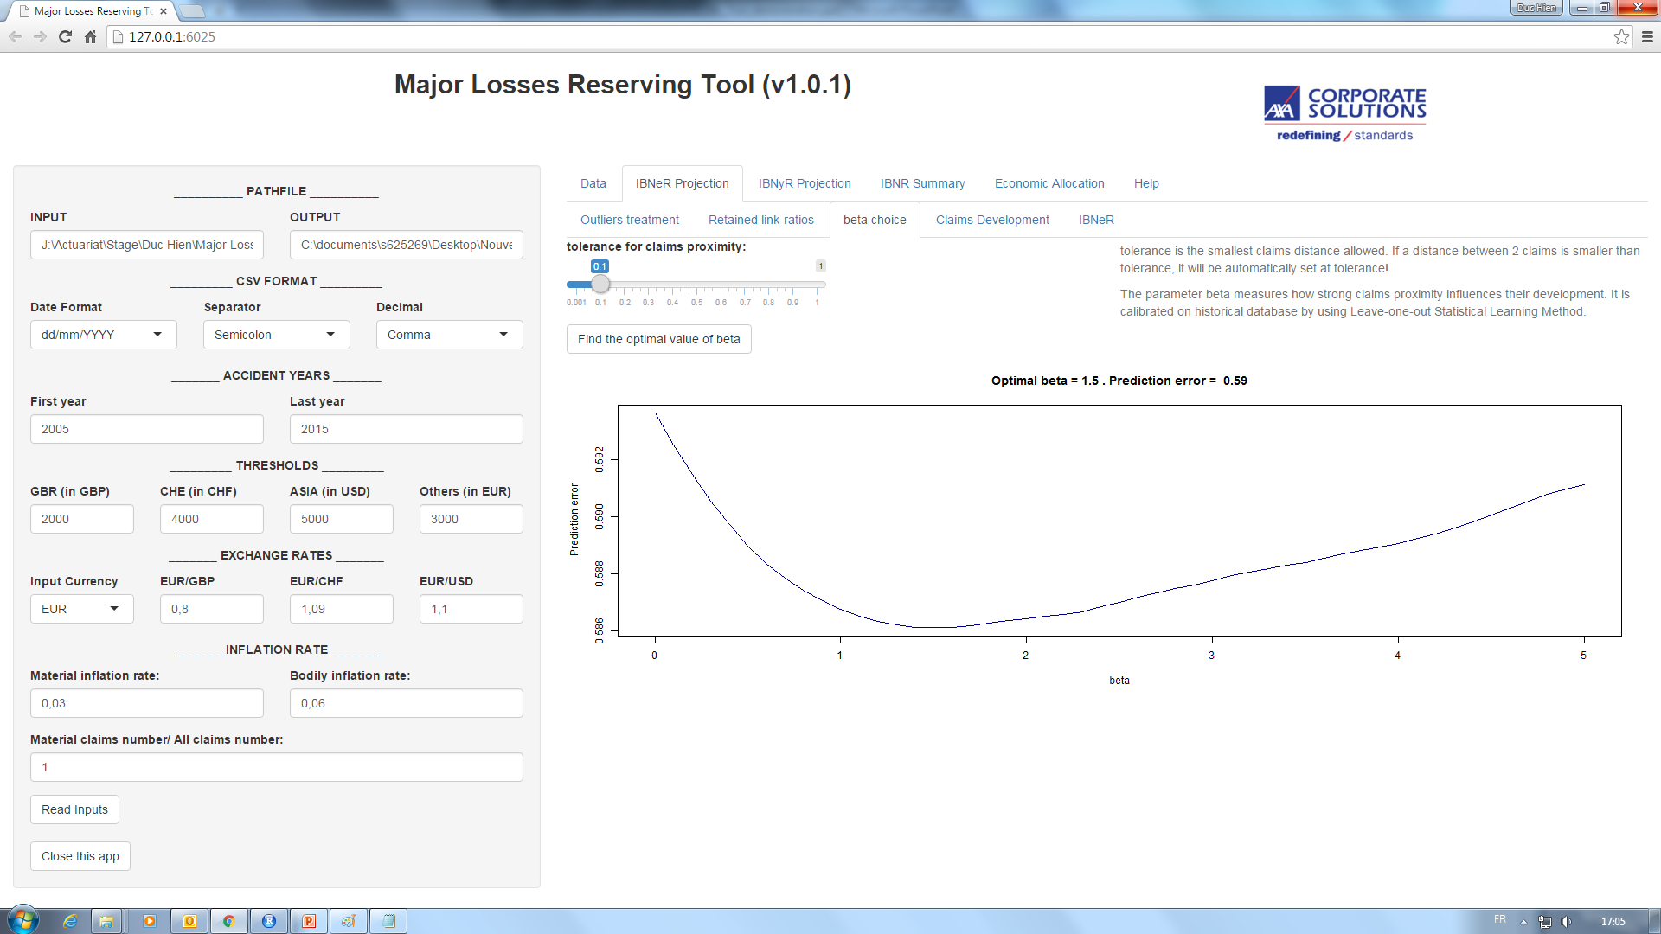

The parameter beta measures how strong claims proximity influences their development. It is calibrated on historical claims data by using « Leave-one-out » Statistical Learning Method.
Tolerance is the smallest claims distance allowed. If a distance between 2 claims is smaller than tolerance, it will be automatically set at tolerance.
Optimal beta = 1.5 – Prediction error = 0.29

Slide 21
4
IBNyR Projection
Frequency-Severity approach
Notes:
The background color can be changed using the slide’s background color commands (preferably using the color palette). Note that we recommend using either this color or that of the following slide (10th color of the predefined palette).
(right click on the slide + “Format background”). Here, the 4th color of the predefined palette was chosen.

Slide 22
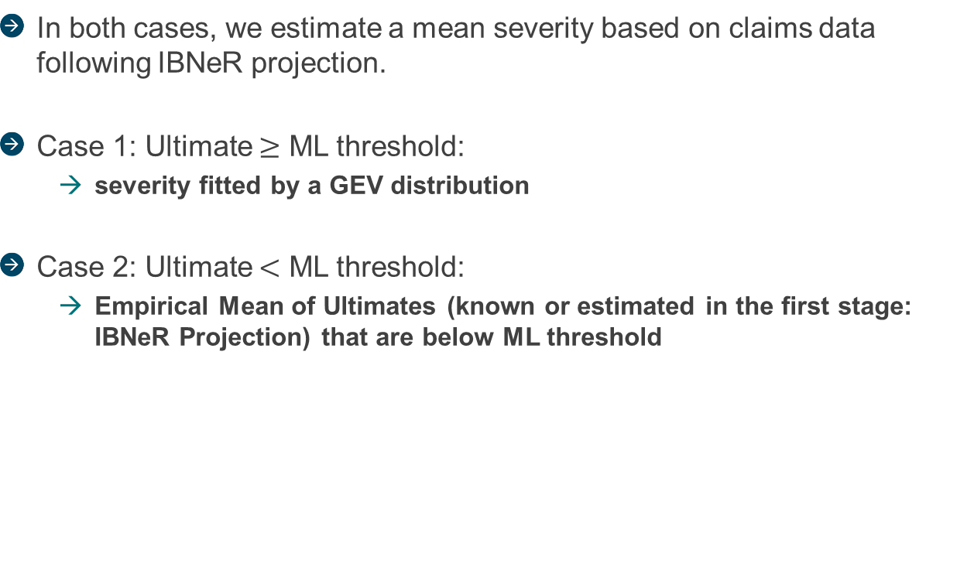
IBNyR projection
Severities Estimation (Overview)
In both cases, we estimate a mean severity based on claims data following IBNeR projection.
Case 1: Ultimate $≥$ ML threshold:
severity fitted by a GEV distribution
Case 2: Ultimate $<$ ML threshold:
Empirical Mean of Ultimates (known or estimated in the first stage: IBNeR Projection) that are below ML threshold

Slide 23
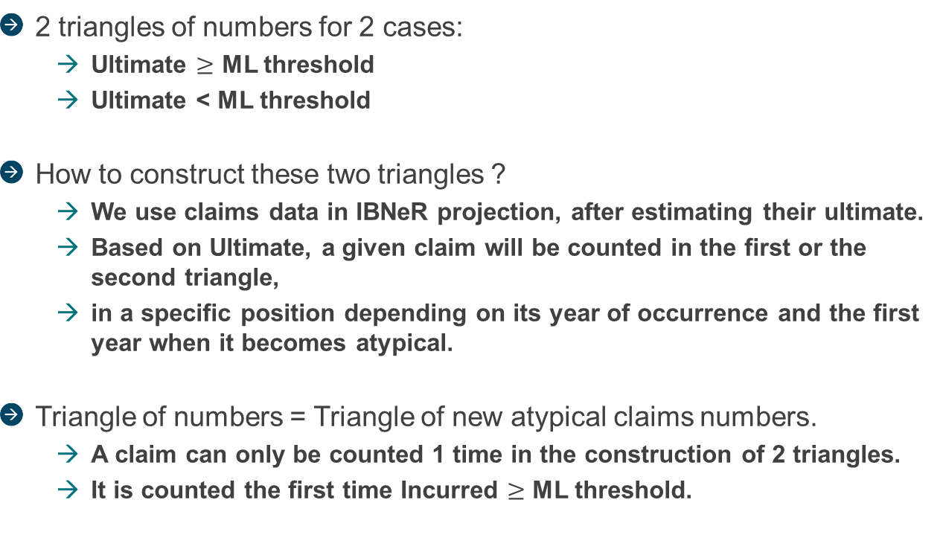
IBNyR projection
Frequency Estimation (Overview)
2 triangles of numbers for 2 cases:
Ultimate $≥$ ML threshold
Ultimate < ML threshold
How to construct these two triangles ?
We use claims data in IBNeR projection, after estimating their ultimate.
Based on Ultimate, a given claim will be counted in the first or the second triangle,
in a specific position depending on its year of occurrence and the first year when it becomes atypical.
Triangle of numbers = Triangle of new atypical claims numbers.
A claim can only be counted 1 time in the construction of 2 triangles.
It is counted the first time Incurred $≥$ ML threshold.

Slide 24



IBNyR projection
Frequency Estimation (Overview)
Example: 1 claim occurred in 2010, went atypical in 2012 (N+2). We estimate its Ultimate via the IBNeR projection
Case 1: Ultimate $≥$ ML threshold
Case 2: Ultimate $<$ ML threshold
N N+1 N+2 N+3 N+4
N N+1 N+2 N+3 N+4
2010
2011
2012
2013
2014
+1
2010
2011
2012
2013
2014
+1
2 triangles of numbers to be developed by a same method …

Slide 25
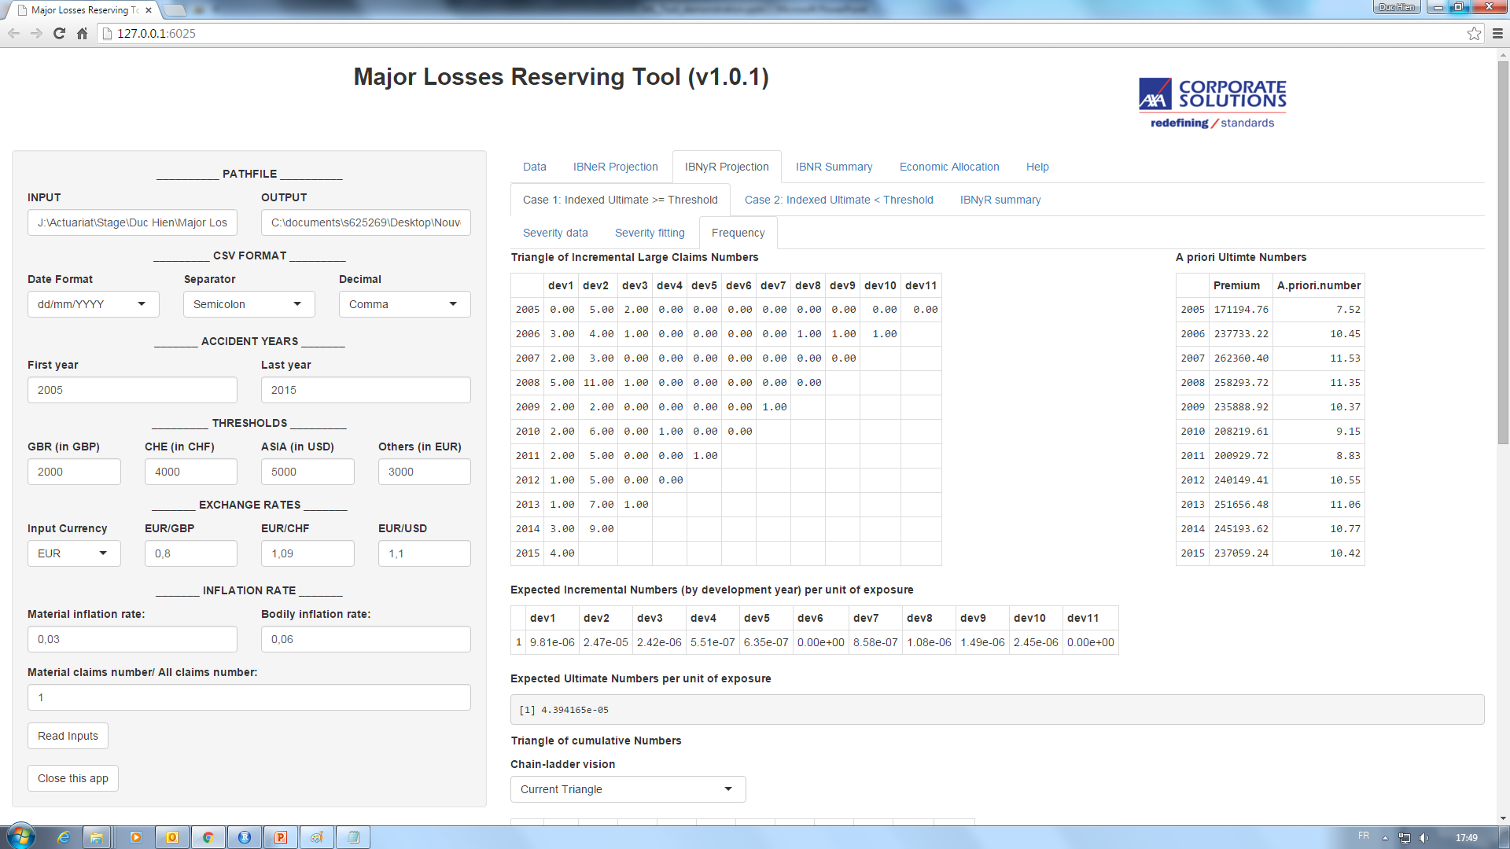
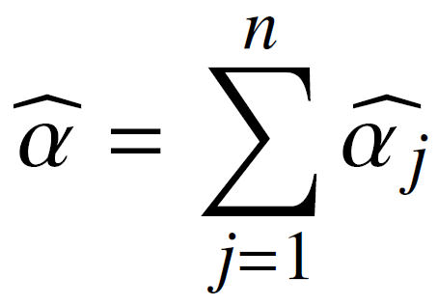
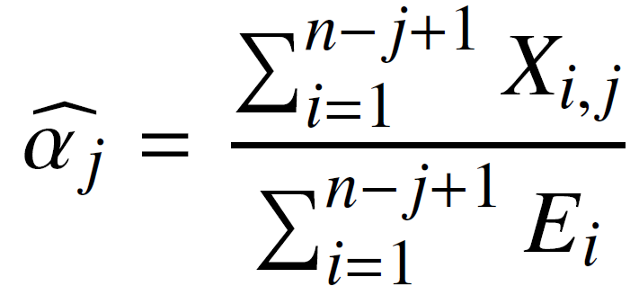


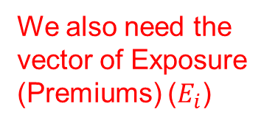
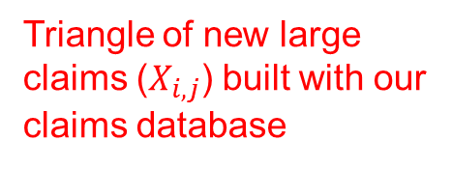
Number of IBNyR claims with Ultimate $≥$ Threshold
For each claim that settles above the threshold, we determine when it got above the corresponding threshold (depending on the branch to which this claim is attached).
ALR « a priori »
Example: this cell tells us that there are 5 claims occurred in 2005 that became ML in 2006 and settled above the threshold at their ultimate
Triangle of new large claims ($X_{i,j}$) built with our claims database
This is how we build this triangle of incremental numbers
(numbers of attritionnal claims going above the threshold to become large claims & large claims directly reported)
Expected number of large claims notified in the 1st development year
$$\hat{α_{1}}$$
We also need the vector of Exposure (Premiums) ($E_{i}$)
$$\hat{α_{2}}$$
Expected ultimate number of large claims per unit of exposure
Method derived from Bornhuetter-Ferguson:
_ Prior ultimate numbers of large claims (ALR)
_ Claims development Pattern (Chain-ladder)

Slide 26


Number of IBNyR claims with Ultimate $≥$ Threshold
ALR « a priori »
$$\hat{μ_{i}}= \hat{α} ×E_{i}$$
Exposure $E_{i}$
Expected ultimate number of large claims per unit of exposure

Slide 27
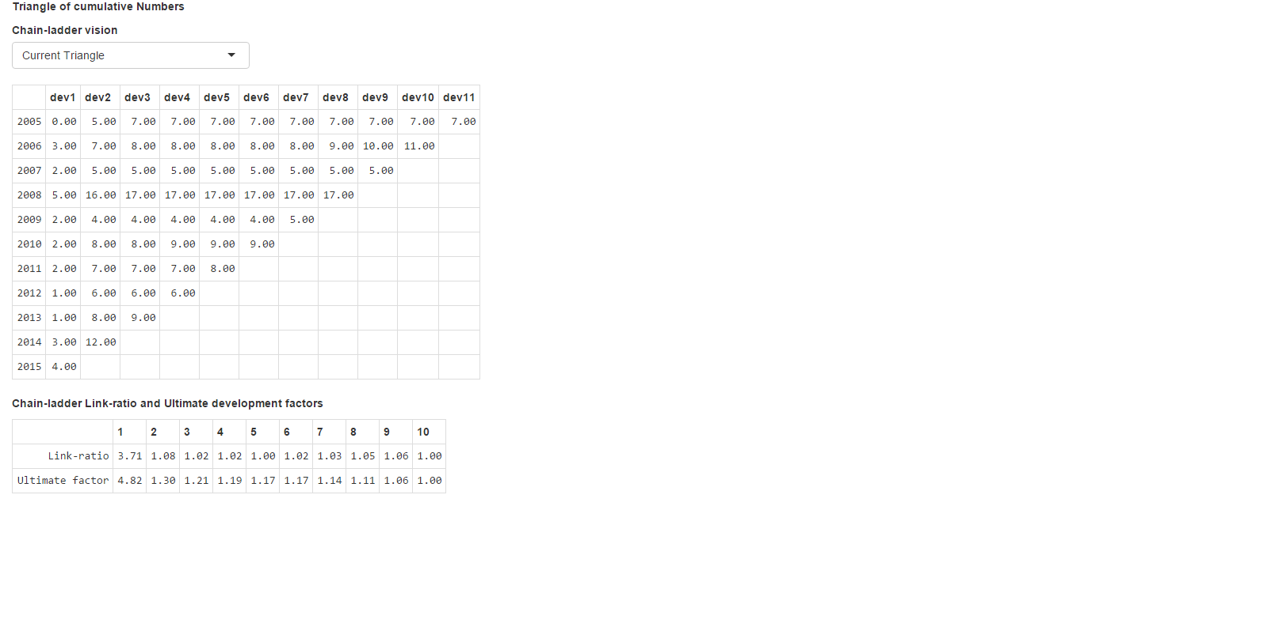
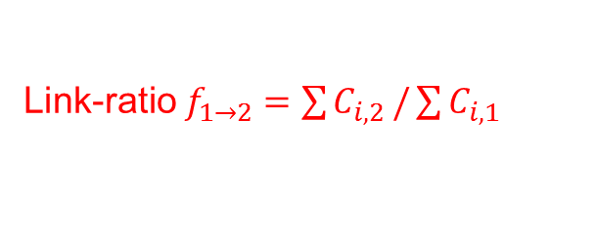
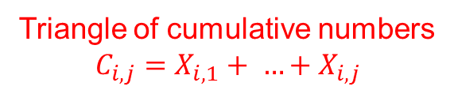




Number of IBNyR claims with Ultimate $≥$ Threshold
ALR « a priori »
Chain-ladder pattern
Triangle of cumulative numbers
$$C_{i,j}=X_{i,1}+ …+X_{i,j}$$
For accident year 2014, 1/ 1.30 $=$77% of large claims were notified by the end of 2015 (known part)
For accident year 2015, only 1/ 4.82 $=$21% of large claims were notified (known part)
$×$1.30
15,58
$×$4.82
19.29
Link-ratio $f_{1→2}=\sum{C_{i,2}}/\sum{C_{i,1}}$
Ultimate factor for developing claims number from the first development year. It is the product of link-ratios.

Slide 28
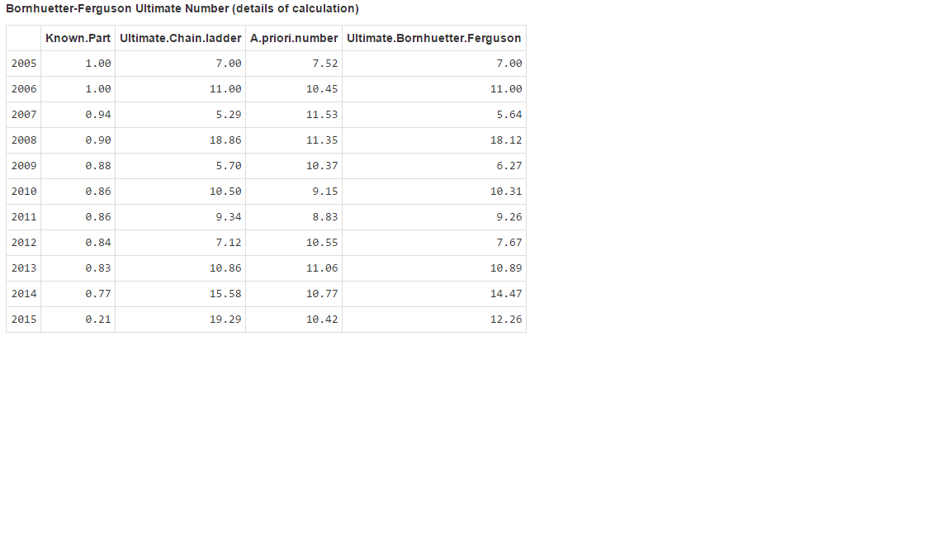


Number of IBNyR claims with Ultimate $≥$ Threshold
Chain-ladder pattern
Bornhuetter-Ferguson
Chain-ladder pattern
(the vector of weight)
ALR prior
Ultimate Chain-ladder
Ulitmate Bornhuetter-Ferguson
Interpretation 1:
Ultimate BF = weighted mean of Ulimate CL and ALR Prior
Interpretation 2:
Ultimate BF = Known number + Reserve
12.26 = 4 + (1 – 0.21) $×$ 10.42
12.26 = 0.21 $×$ 19.29 + (1 – 0.21) $×$ 10.42
4
known number of large claims occurred in 2015
We multiplied known part estimated by CL with Ultimate CL

Slide 29
5
Economic Allocation
Between the different AXA CS branches
Notes:
The background color can be changed using the slide’s background color commands (preferably using the color palette). Note that we recommend using either this color or that of the following slide (10th color of the predefined palette).
(right click on the slide + “Format background”). Here, the 4th color of the predefined palette was chosen.

Slide 30
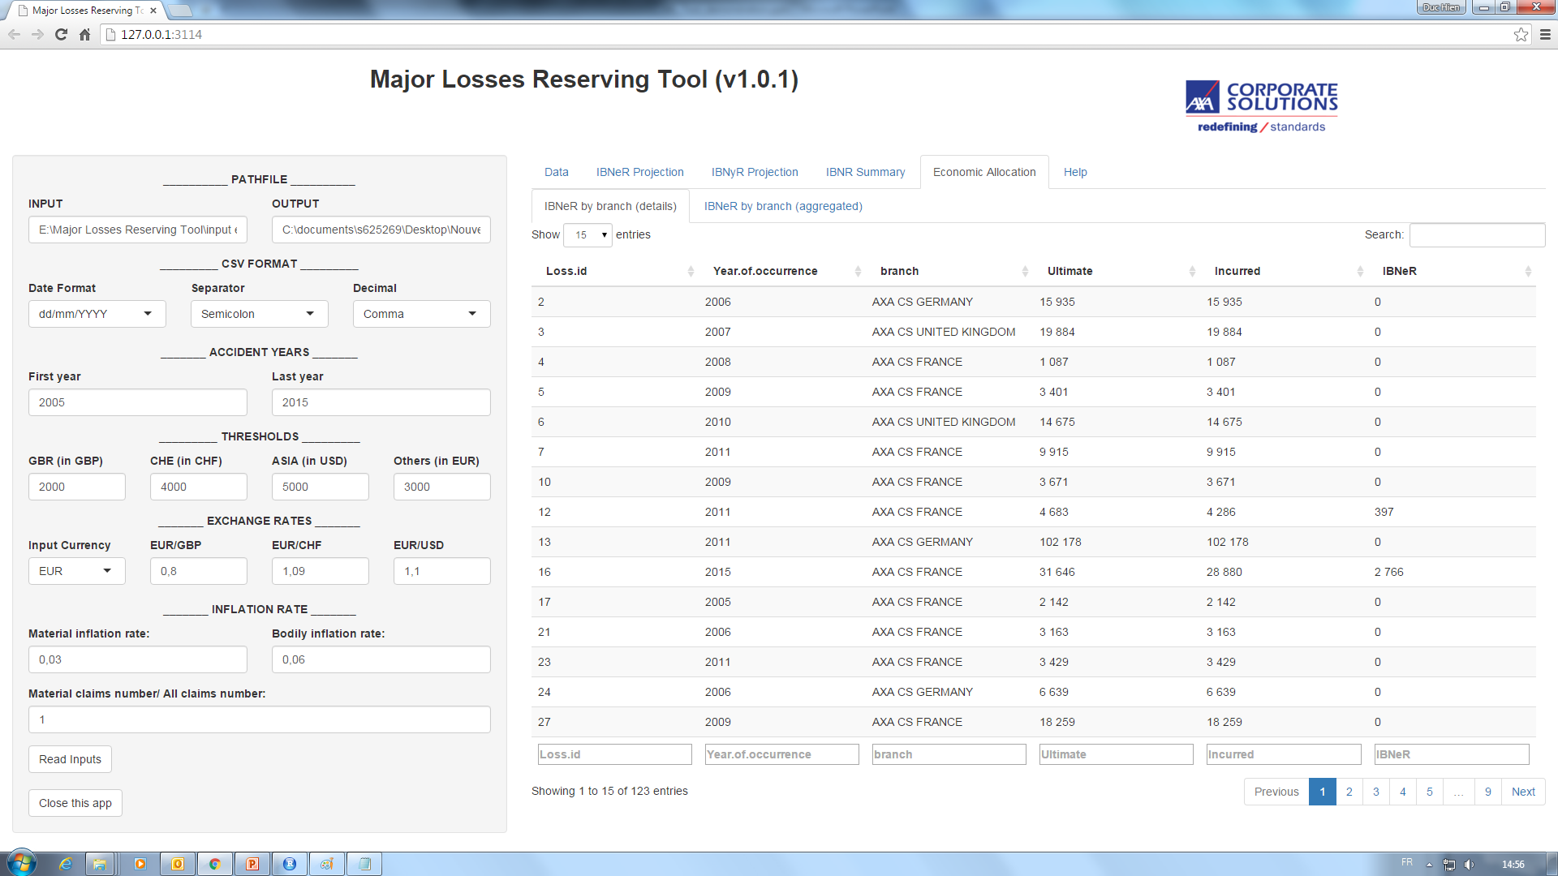
Economic allocation between the different AXA CS branches
Thanks to an individual development, we can identify the IBNeR amount for each claim.

Slide 31
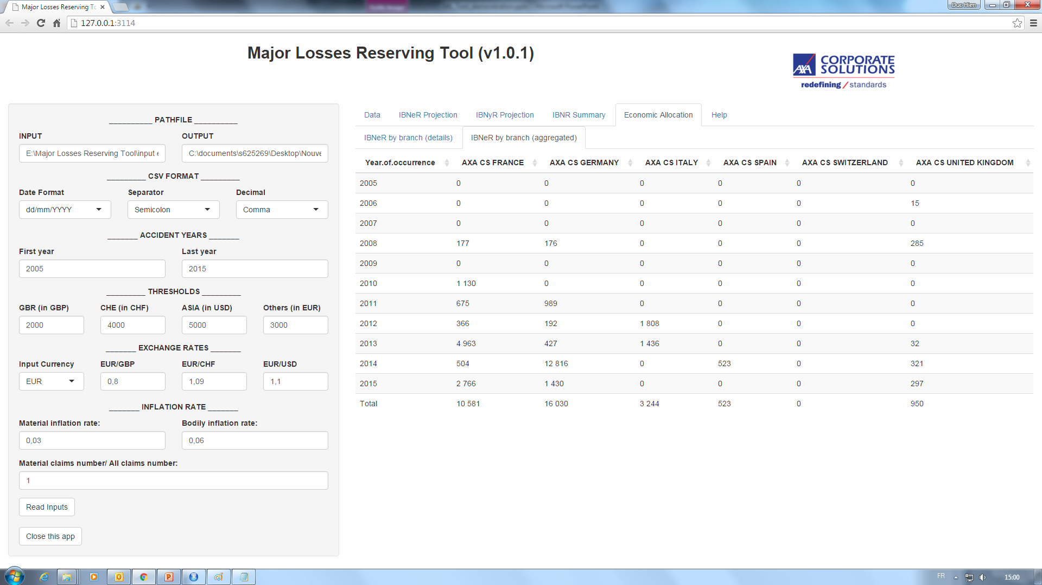
Economic allocation between the different AXA CS branches
And then aggregate IBNeR reserves by AXA CS branch!

Slide 32
Limits & Perspectives
Notes:
The background color can be changed using the color commands of the slide background (preferably selecting from among the colors of the predefined palette).
(right click on the slide’s background + “Format background”).

Slide 33
Limits & Perpectives
Inflation model
Measure of distance (Incurred, Paid, Branch, etc.)
Severity fitting
Dependency of the IBNyR Projection on the IBNeR Projection
A priori estimator of Large Losses numbers (Exposure & Ratio)
IBNyR allocation

Slide 34
Thank you for your attention
Duc Hien Vu
November 2015

Slide 35
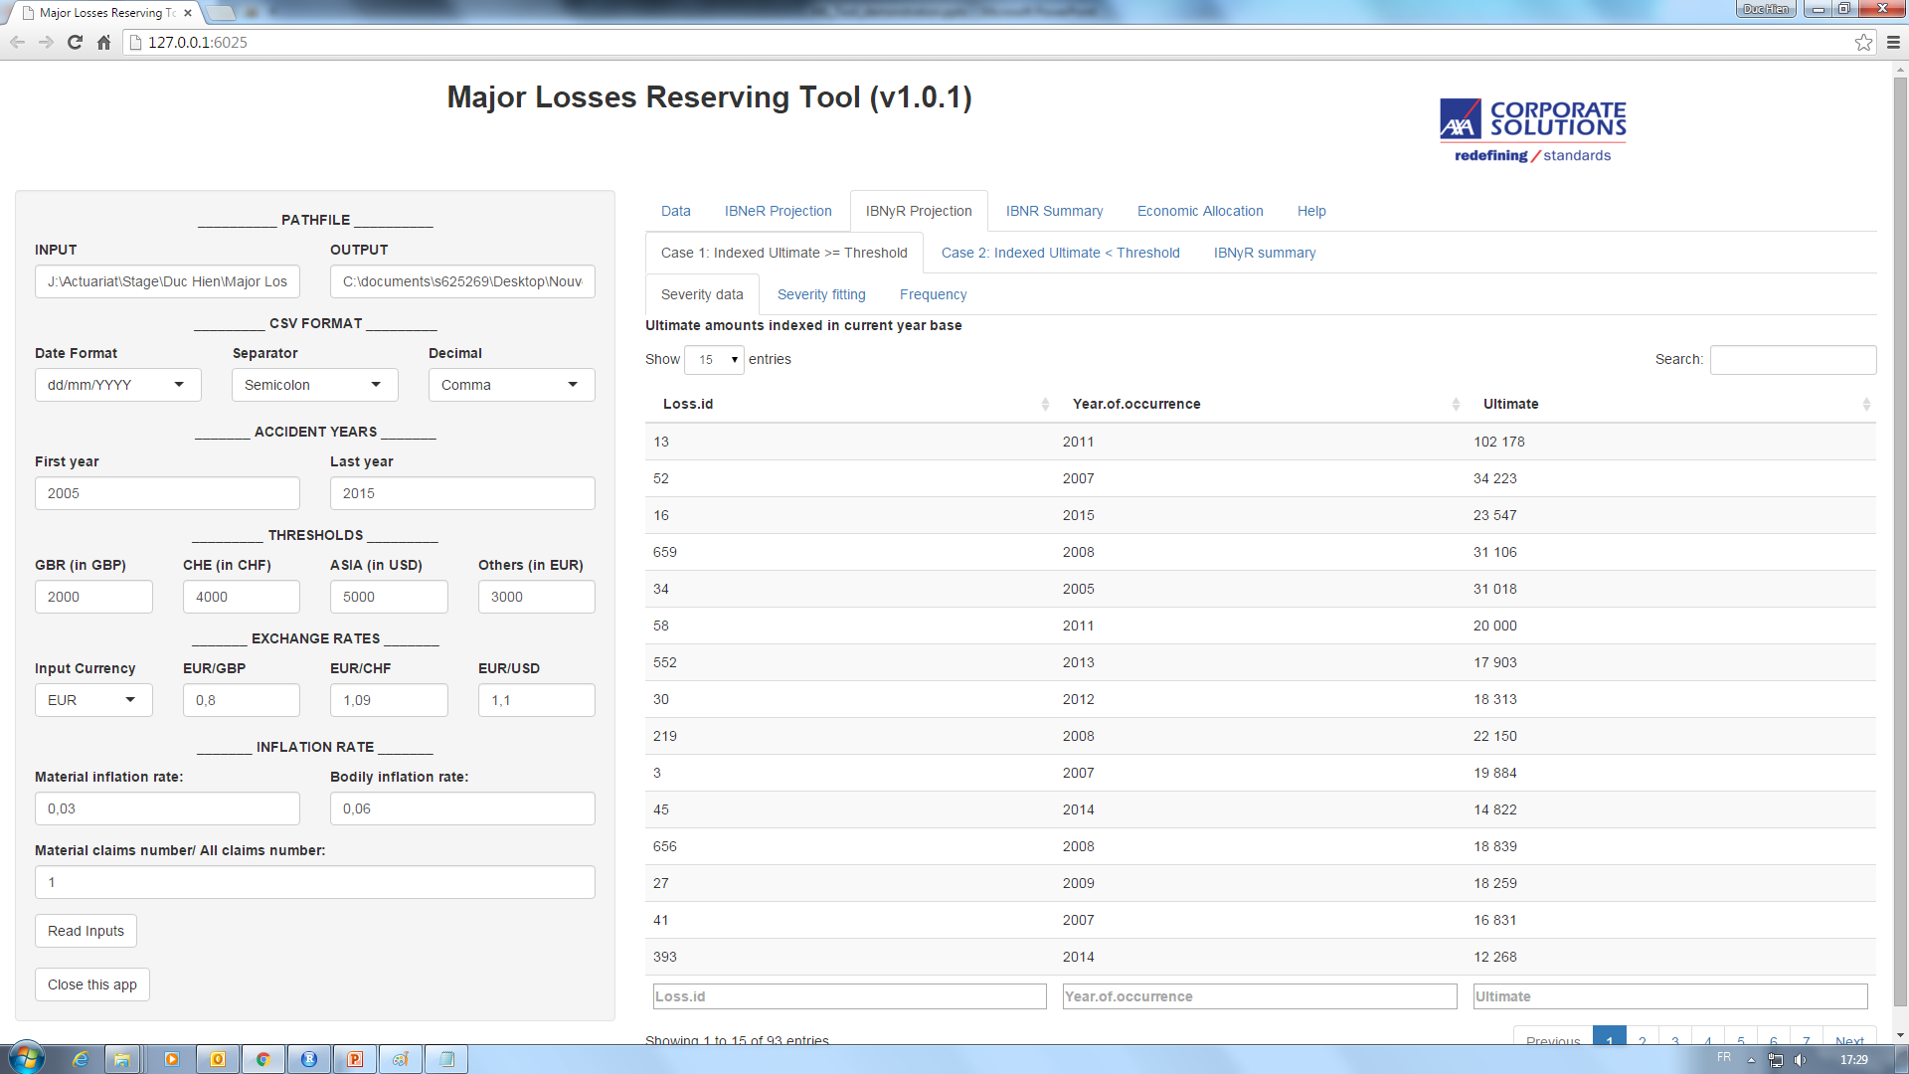

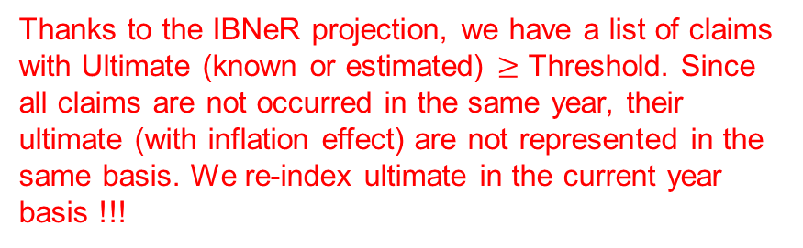
IBNyR Projection – Case 1: Ultimate $≥$ Threshold
Thanks to the IBNeR projection, we have a list of claims with Ultimate (known or estimated) $≥$ Threshold. Since all claims are not occurred in the same year, their ultimate (with inflation effect) are not represented in the same basis. We re-index ultimate in the current year basis !!!

Slide 36
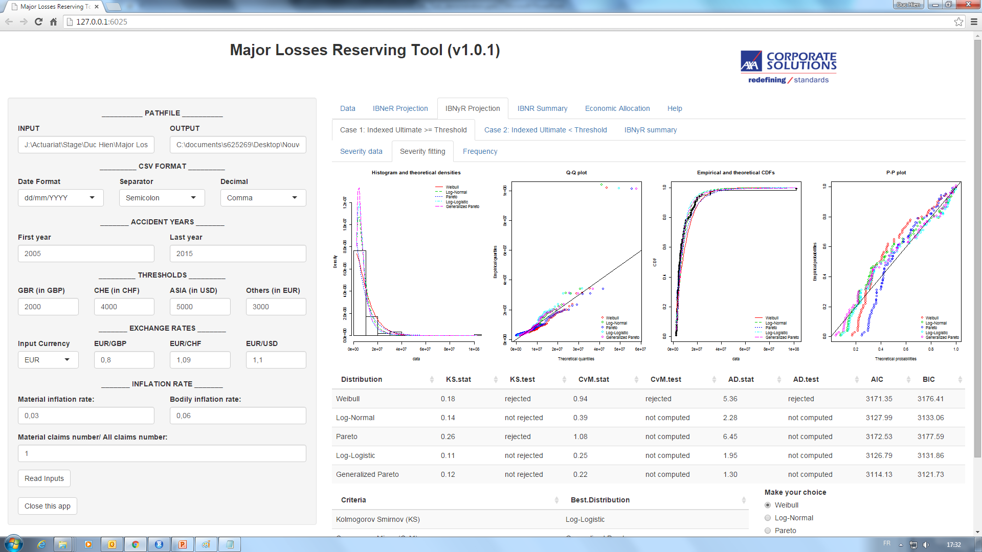
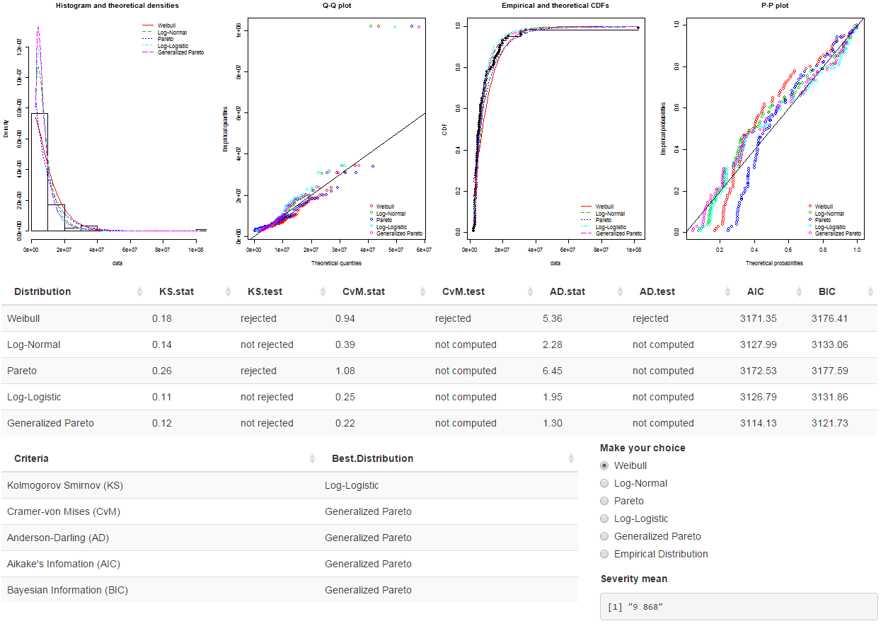

We then fit a Generalized Extreme Distribution on those Ultimate amounts
Different Goodness of Fit tests
Mean of severity (current year basis)

